Slide 1
Getting Started with a Mendix Project

Slide 2
Sign Up
Notes:
Use for this part the Mendix sales slide deck or custom created slide deck introducing Mendix

Slide 3
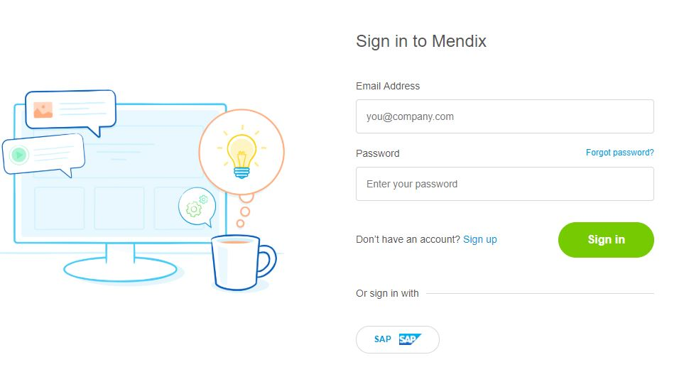
Sign Up Steps
Go to home.mendix.com
Click Sign Up
Enter your name and email
User your University email address to get all the FREE benefits

Slide 4
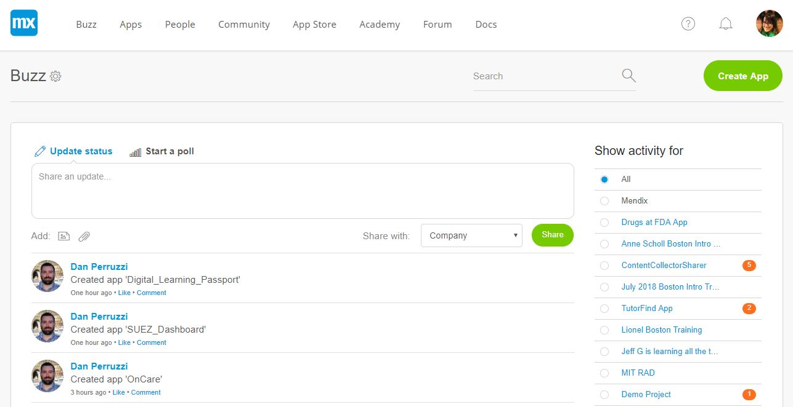
Orientation
Buzz – University Activity
Apps – All Apps you are part of
People – your university students
Community – our developer community + documentation
App store – reusable documentations
Academy – our online FREE learning tutorials
Forum – have a question or problem? Ask the community!
Docs – our online documentation can be found here

Slide 5
Project Overview
Notes:
Use for this part the Mendix sales slide deck or custom created slide deck introducing Mendix

Slide 6
Ready to Build an App?
Click on Create App
Select your starter template
Give your project a name
Wait for Magic to Happen

Slide 7





Mendix App Structure
Collaborate
Invite Team
Manage Stories
Feedback
Documents
Develop
Team Server
Planning Tools
Deploy
Environments
Mobile App Stores
App Services
Operations
Metrics
Alerts
Logs
Back Ups
Settings
General
Security
API Keys

Slide 8
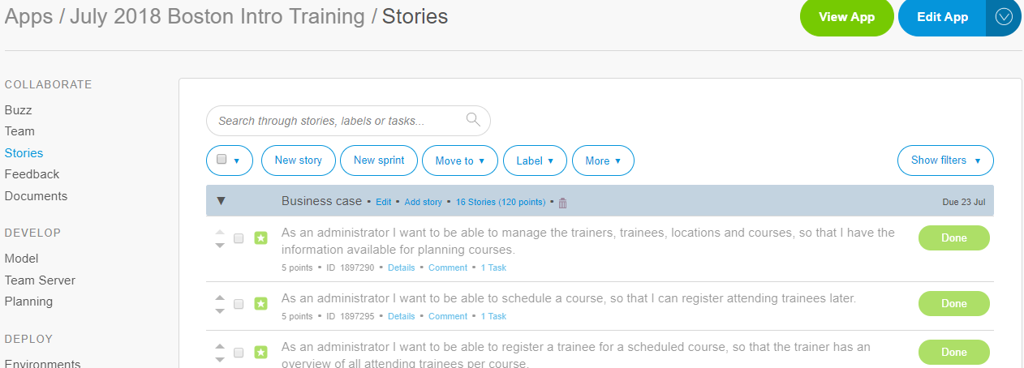
Mendix App - Collaboration
Buzz – what’s the latest buzz in the project?
Team – invite others to your project to collaborate and build the app
Stories – manage your user stories and user cases in one place and follow agile industry practices
Feedback – your users will provide you with valuable feedback and you can find it here
Documents – share your project documents by uploading them here

Slide 9
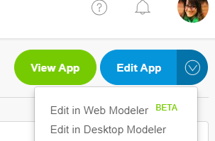
Mendix App - Develop
Ready to Develop?
Click on Edit App
Edit in Web or Desktop Modeler
Follow our learning path to learn more:
LEARN.MENDIX.COM

Slide 10
Mendix App – Web vs Desktop Modeler?
Web Modeler
Desktop Modeler
Web based modeler
No download needed
Beta Mode
Basic and limited functionality
Need to download executable file here
Development environment (like eclipse for java)
Full functionality and features enabled

Slide 11
Happy Modeling!
Notes:
Use for this part the Mendix sales slide deck or custom created slide deck introducing Mendix

